Slide 1


Corporate Overview
DIGITAL TRANSFORMATION. HUMAN INNOVATION.

Slide 2

With innovation at our core, we drive digital transformation through a combination of IT services and technology staffing

Slide 3

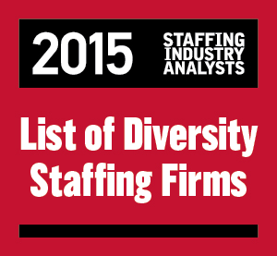





Key Highlights
Pittsburgh-headquartered
Mastech Digital revenues @ $147.9 million
Minority-owned (Certified with NMSDC)
NYSE-listed (MHH)
Data Management & Analytics consulting
Technology-based recruiting delivery
Hybrid Delivery Model (North America and India)
Faster turnaround time
Successful engagements with leading clients across industries
Financial Services
Insurance
Healthcare
Manufacturing
Retail
Energy
Telecom
Aviation
Awards

Slide 4
Our Transformation Journey
Mastech 1.0 Pre-2016
Mastech 1.5 2016
Mastech 2.0 2018
Maintained consistent growth as a premier IT staffing company in the U.S.
Rebranded as Mastech Digital, with recast services, a focus on digital staffing, and the introduction of digital transformation services
Transformed Mastech Digital into a digital technologies company with deep capabilities in Data Management and Analytics

Slide 5




Offerings
Digital Transformation Services
Data Management & Analytics | Cloud CRM | Enterprise Efficiency | Digital Learning Services
Digital Staffing
Social | Mobility | Analytics | Cloud | Automation
Mainstream Technology Staffing
Mainframes | Databases | Middleware | Enterprise Systems | SoA and Web Services | Data Warehousing | Verification and Validation | IT Administration | IT Helpdesk and Support Business Analysis | Project Management| Microsoft | Open-source Technologies

Slide 6

Data Management & Analytics
Optimize the value of your enterprise data assets through our information management offerings

Slide 7

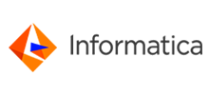










Data Management & Analytics
Offerings
Partners
Master Data Management Get a unified view of your enterprise data assets for increased operational efficiency
Enterprise Data Integration Extract, transform, and load data from disparate sources to centralized data repositories
Big Data & Analytics Have a self-service Analytics Hub generate actionable insights for your enterprise

Slide 8
Delivery Model
Program Sponsor
Client Partner
Global Delivery
Manager
Project Support and Oversight
Principal (on-site)
Mastech InfoTrellis
Client
Project Manager (on-site)
Project Manager
Solution Architect
Project Manager
Enterprise Architect
Shared Services
Technical Consultants
Business Domain SMEs
Data Stewards
Technical Consultants
QA Consultant
On-site
Offshore
Client Team

Slide 9

Cloud CRM
Create the right digital customer engagement ecosystem in your enterprise powered by Salesforce

Slide 10





Salesforce
Offerings
Quick Start Get up and running, fast, enabled by our ability to react to your needs, allowing you greater flexibility and faster decision making
Re-engineering Change your existing instance to keep up with business dynamics
Assessment & Roadmap Develop an understanding of your current state and plan a roadmap to your desired state of implementation
User Adoption & Change Management Make every user a power user with a customized change management program for better adoption and greater success
Integration Combine with other applications in ERP, marketing automation, or your data warehouse to derive greater value from your instance

Slide 11


Salesforce
Practice Highlights
To ensure you optimize your Salesforce® success, Mastech Digital can help pair you with the right solution to get the most out of a Salesforce® investment. Our tailored engagement offerings eliminate the most common technology roadblocks, helping many customers devote their time to growing their business.
Team Overview
Focus Areas
Proven Success
Salesforce Practice Lead with over 25 years of experience, with a specialty in the pharmaceutical and manufacturing verticals
19+ consultants involved in the practice, today
Helped enable more than 3,000 employees
Salesforce Connect
Sales Cloud
Service Cloud
Salesforce Lightning
Apps on Salesforce
Partner Communities
Salesforce Sales Cloud Einstein
Eliminating swivel-chair interfaces and harmonizing processes under one umbrella
Reducing response time to customers and branding a full-cycle, customized sales process
Providing visibility into divisional sales data and unifying Global Salesforce reporting across orgs.

Slide 12
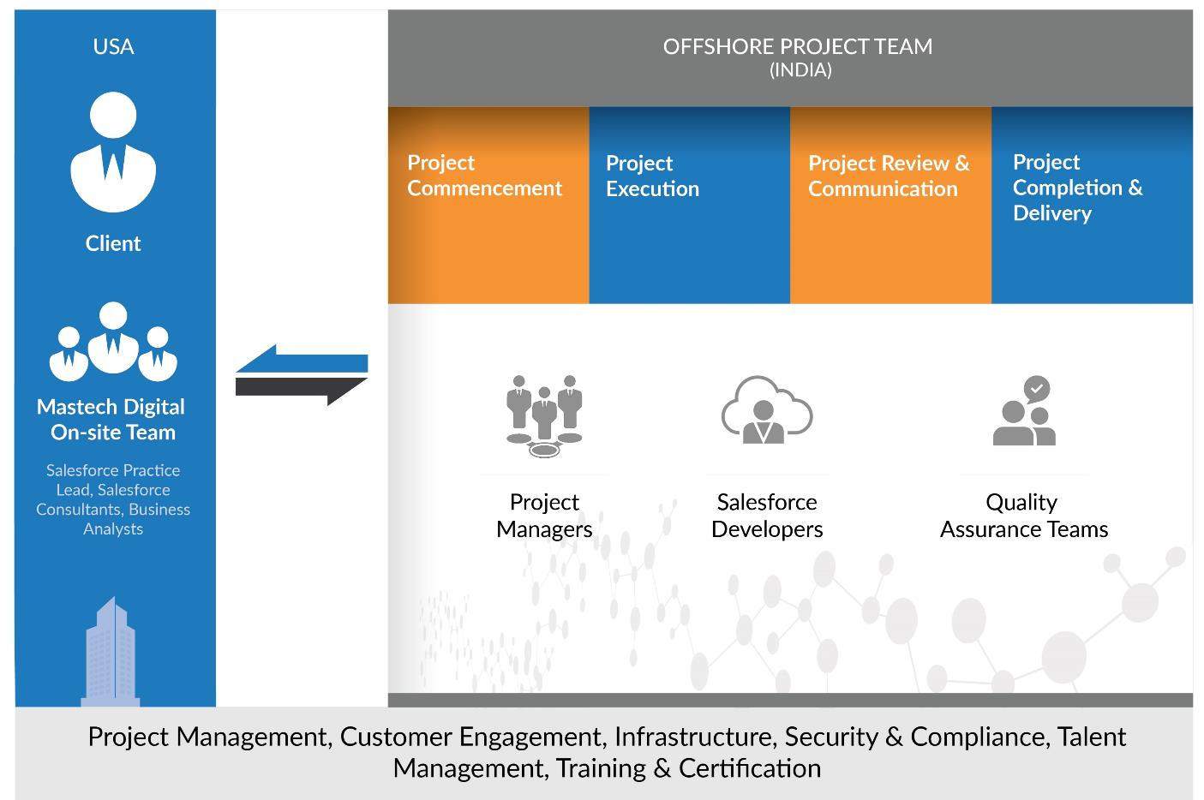
Delivery Model

Slide 13

Enterprise Efficiency
Faster implementation of SAP HANA for increased business efficiency across the enterprise

Slide 14




SAP HANA
Offerings
Discovery & Roadmap A brief session to understand your systems and plan the optimal Road-to-HANA
Integration The right on-premise deployment via Tailored Data Center Integration (TDI)
Navigator A workshop to help you strategize the right way to get to your desired destination
Support Monitor, predict, and fix issues with around-the-clock support
Migration Carefully move your existing IT instances to SAP HANA via tested methodologies
IoT & IoE Operationalize IoT & IoE to transform into a Quantifiable Self-Aware Enterprise

Slide 15



Delivery Model
Delivery Team
Project/Program Managers | Functional and Technical CRM Specialists | Business Intelligence Experts | ABAP/Netweaver Technology Specialists | BASIS Experts | SAP Functional Experts | Quality Assurance Teams
Security & Access Control
Process & Procedures
Training
Customized Protection
Biometric and fingerprinting access cards, complete tracking/ trail
Virtual-LAN for dedicated teams
Physical separation between teams, control over portable media/mails, etc.
Firewall administrative procedures and regular audit log review
Drive to create an IP-focused environment
Regular workshops educating employees on IP rights
Enforcement of IP protection in employment contracts by tough penalties
CCTV video surveillance, if required
Biometric access control and verification systems
No removable media; disabled USB ports
Restricted internet access
Document destruction

Slide 16

Digital Learning
A combination of digital and physical modes of learning to ensure unified, augmented performance across teams

Slide 17



Digital Learning Services
Offerings
Analysis & Roadmap Plan a custom learning program based on an assessment of your current learning needs and performance levels
Digital Content Videos, web applications, presentations, games, and more carefully woven into your personalized learning program
Instructional Design A goal-driven, learn-by-doing approach to determine and create what a participant can thoroughly understand and store, long-term
Implement & Evaluate Train-the trainer sessions, and constructive reviews to evaluate effectiveness

Slide 18

IT Staffing
Enable your digital transformation journey with the right skills across digital and mainstream technologies

Slide 19
IT Staffing (On-Premise)
Offerings
Digital Technology Staffing Social Analytics | Social Campaign Management | Enterprise Mobile Strategy | Mobile App Development | Deploying & Debugging | Data Science & Engineering | Decision Science & Support | Cloud Strategy, Implementation, & Support | Automation Engineering | R&D specialists | QAs | Embedded Technologies | Platform Engineering | Instructional Design | Multimedia Content Development | UI/UX Experts
Mainstream Technology Staffing Mainframes | Databases | Middleware | Enterprise Systems | SoA and Web Services | Data Warehousing | Verification and Validation | IT Administration | IT Helpdesk and Support | Business Analysis | Project Management | Microsoft | Open-source Technologies

Slide 20
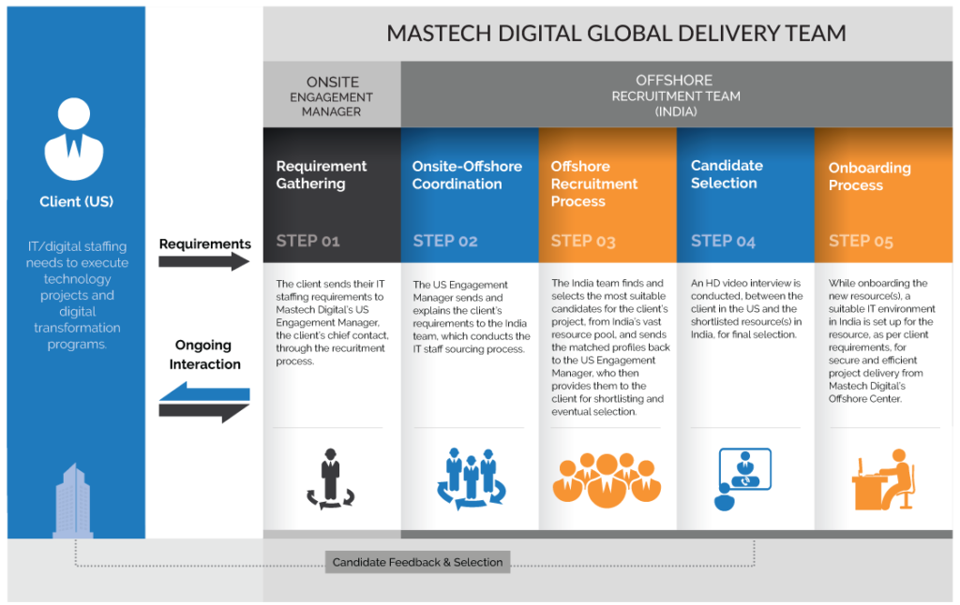
Offshore Staffing Model (OSM)

Slide 21

Sourcing Strategy
Review/qualify the job order to clarify skill set/technology being recruited (with the Account Developer and potentially with client, if necessary)
Search and review recently finished and pending ends of existing Field Associates/Consultants for fit
Review previously-screened candidates, organized by skill set, in Applicant Tracking System – Bullhorn
Post job on all “Global” job boards through a job distributor (Monster, CareerBuilder, Dice, Mastech Digital, etc.) and post to social media platforms (Twitter, LinkedIn, etc.)
Post job to at least two relevant niche sites (geographic or by skill set – Craig’s List, ColdFusion User Group, .Net User Group, Java User Group, National Center for Simulation, etc.)
LinkedIn & LinkedIn Recruiter: Network through 1st, 2nd, and 3rd degree contacts, and send Inmails
Search Bullhorn to identify viable candidates
Candidate resume search (Boolean, search by job title, etc.)
Previous requirement search (based on similar skill set)
Mastech Digital interview search over the last 30-90 days (network with interviewed candidates and contact at least 10 related candidates)
Call candidates with similar skills, in same geography, for referrals (contact all active employees with skills related to the job order)
Completed within 2 hours of receiving a new job order

Slide 22

Sourcing Strategy
Set-up agents/alerts on Monster, CareerBuilder, Dice, LinkedIn (Utilize LinkedIn Recruiter) and contact new people daily
Search Online Databases (Monster, CareerBuilder, Dice, LinkedIn, Craig’s List, job-specific sites such as JavaJobs.com, OracleJobs.com, etc.)
Contact and distribute to approved third-party agency contacts
Dedicated Internet Mining (non-job board)
Brainstorm with Account Developer, fellow recruiters, and/or Sales Lead/ Director regarding other companies in the market with similar skill profile, and a develop target company list (min. 5 companies) and refine/target current employees of those companies in searches/calls
Identify and contact reference names with relevant job titles or candidates who work at targeted companies with relevant technology environments (i.e. reference of local Project Manager working at Microsoft, or Web Developer working at company that has a .Net development environment, Boolean search – NEAR)
Identify at least one related user group and actively engage

Slide 23

Locations & Infrastructure

Slide 24

Toronto
Boston
Fremont
Pittsburgh
Chicago
Dallas
Austin
Orlando
Tampa
NOIDA
Chennai

Slide 25





NOIDA Office
Total Area 27,000 sq. ft.
# of Workstations 204 (plus 7 manager cabins and 1 CEO cabin, 3 meeting rooms, 2 training rooms, and 1 conference room)
Distance from Airport 21 mi. (34km)
Location Right next to the NOIDA Expressway, amidst many prominent, global IT companies
Campus IT Business Building | Multi-tenant location

Slide 26
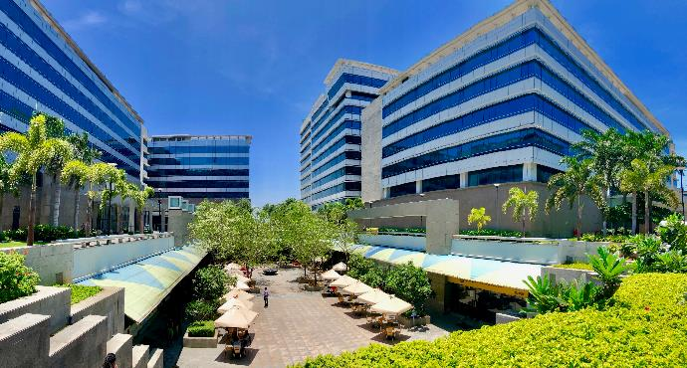
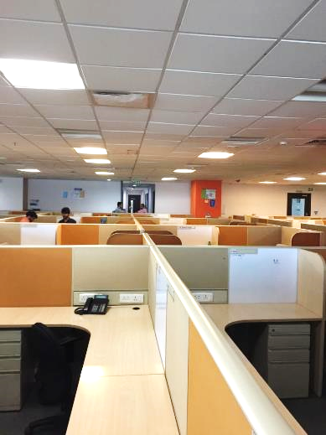
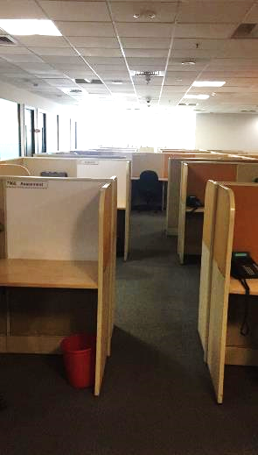
Chennai Office
Total Area 19,500 sq. ft.
# of Workstations 210
Distance from Airport 7 mi. (12km)
Location Right next to IT Expressway, where all the IT companies are situated
Campus IT Business Park | Multi-tenant location

Slide 27

The Mastech Digital Way
With our legacy of being a pioneer in IT Staffing, and our transformation into a digital technologies company, we are now uniquely positioned to deliver on customer digital transformation challenges
Deep capabilities in Data & Analytics, Salesforce, SAP HANA, and Digital Learning
Proven track record of being able to source the native as well as rare skill sets and talent combinations
Metrics and insights to manage your Master Data, powered by Veriscope
Salesforce Registered Consulting Partner
SMART Implementation Methodology – a common-sense, multi-phased approach based on parts of the Rational Unified Process (RUP) and Agile development methodologies
1M+ resumes in our database
Combination of AI and human skills to deliver rapidly
Ready and steady offshore delivery model spread across NOIDA and Chennai
Minority-owned (Certified with NMSDC)
1,500+ associates and growing

Slide 28

Thank You
For queries please contact:
+1.800.627.8323
experience@mastechdigital.com

